Slide 1



2025
Event Management System
with
Logic Legends

Slide 2





Sabiha Khanam
2024-3-60-457
MEET OUR DEVELOPERS
01
developed the code by adding functions. Her function is used for adding events.
Nur Maisha Akter
2024-3-60-459
02
developed the code by adding functions. Her function is used for searching participant by name.
Tasfia Rahman Lefa 2024-3-60-456
03
developed the code by adding functons. Her function is used for generating report .

Slide 3



HEAD OF THE TABLE
Shahriar Hassan Mojumder
creator
MD. Junayed Ahmad Shanto
Designer
Shahriar Hassan Mojumder
2024-3-60-458
MD. Junayed Ahmad Shanto
2024-3-60-455

Slide 4



EVENT MANAGEMENT SYSTEM
We wrote a c code to manage events as an admin.
here,
an admin, can add, update and delete events.
Moreover he can add participants and search participants. An admin, can also generate a report on the events.

Slide 5
FUNCTIONALITIES OF OUR CODE
01
Creating Event
02
Registering Participant
03
Searching Participant
04
Generating Report
05
Updating or Deleting Event

Slide 6

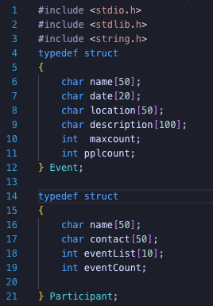
Starting.....................................................................
structure to store information about an event
to store the maximum number of participant for an event
to store the number of participant for an event
structure to store information about a participant.

Slide 7

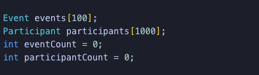

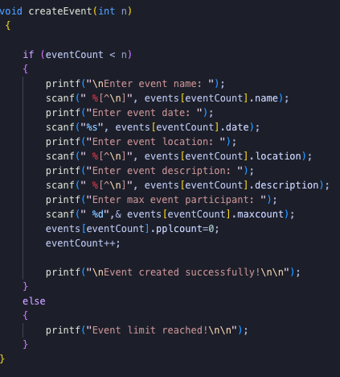

Added global arrays and counters for events and participants.
declared the base event count and participant count
created a custom function to create events
the parameter n is the maximum number of events.
checking if the maximum number of events crossed
taking input from the user
adding the pplcount as 0 because it’s used for
how many participants had joint the event
eventcount increased
custom function to create event

Slide 8


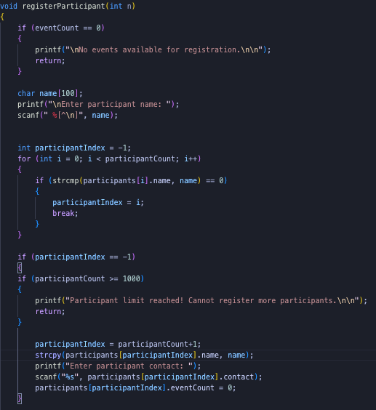



registration of participant
part-01
checking if there were any events for the paricipant
declaring the data type and scaning the name
checking if the participant had registered for any other events
checking if the whole participant limit reached
copying the name in the structure array and scanning the number as input of structure participant

Slide 9
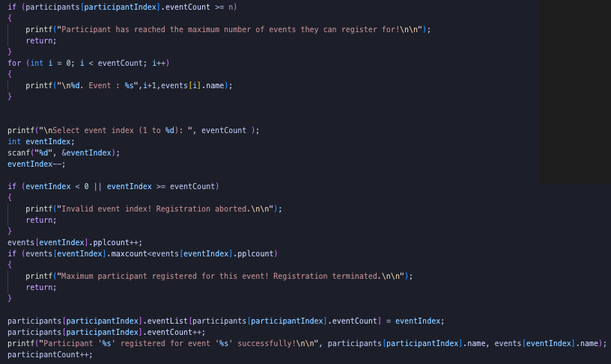
registration of participant
part-02
checking if the participant had already entered all events
printing all the events for scanning the the event index number
checking the validity of of index number
increasing the pplcount for checking the max participant
if all the things are checked then we take the participant as the member of the array
printing the registration is done properly

Slide 10

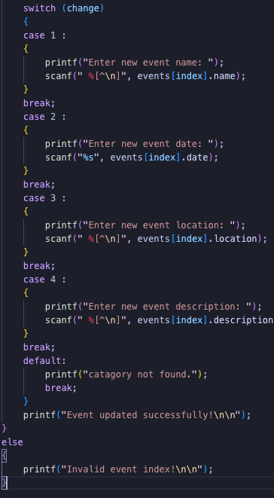
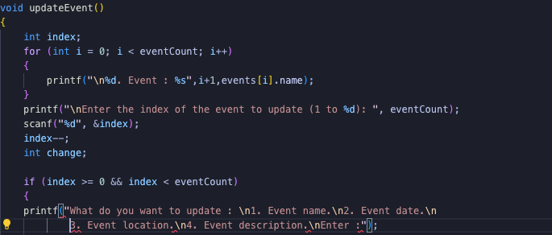
it’s a custom function to update event.
At first here we print the existing events
then select the index number of the event we wanted to change
then we check that if the index number is correct
it’s the switch case to help the user
it takes input what to change
scans the thing that the user wanted to changed

Slide 11

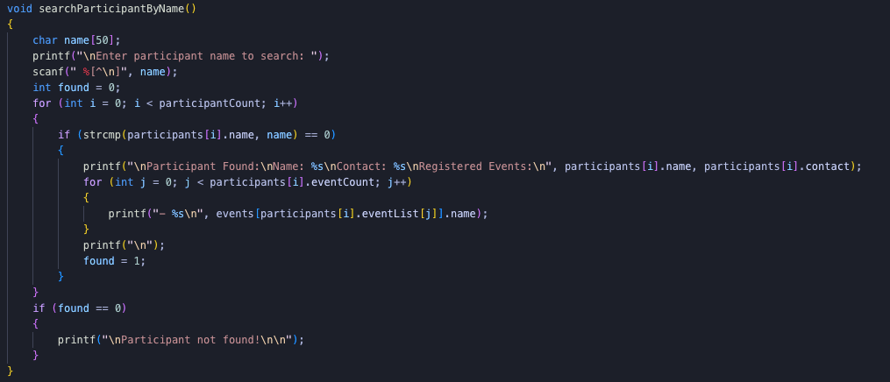
Search participant by name
scanning the name
used a for loop for checking all the participants
comparing every participants name with the target
if found then printing the details of the participants
if not found then printing not found

Slide 12
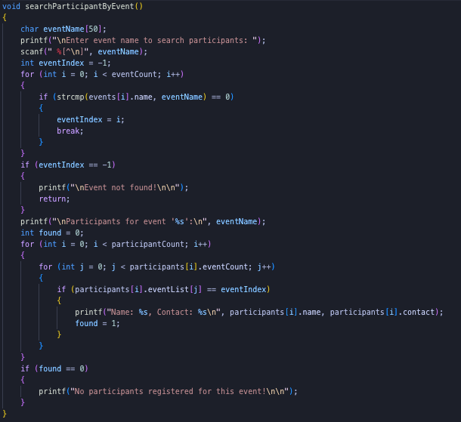
Search participant by events
scanning the event name
checking the event name with every other events
if found then print all the participant in the event
if not found the event then print not found

Slide 13
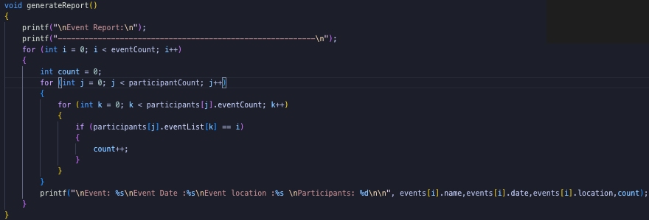


generating report
for every event we count the participants and printing the report for that particular event
using loop to check every participant
using nested loop to check if the participant in the event
after checking everything the report for every events details will be printed in loop

Slide 14

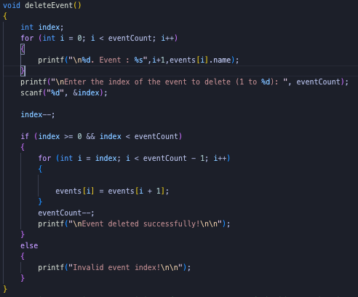
Deleting an event
declared an temporary variable
scanning the event index
checking for the proper input
using a loop for finding the target
if the target event is in last place we just make the array one index shorter
if the target event found then we change it with the next array elements and continue it till the last element
then decrease the array element by one

Slide 15

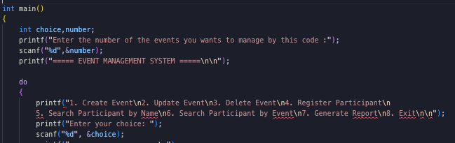
main function
part-01
declaring the variables
taking input for the event number
using a do while loop to print the names of the function
then scanning the number to call an function

Slide 16
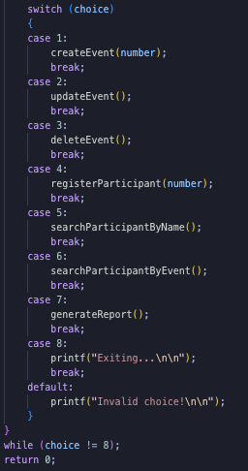
main function
part-02
after scanning the number pass it through the switch
after checking the input switch case calls the appropriate function
after completing the function the do while loop prints the names of the function
after selecting the case number 8 we exit the code

Slide 17

event management system
here we wrote a ‘C’ code to manage some events
it’s just used to create some events, adding some participants and some other functionalities.

Slide 18
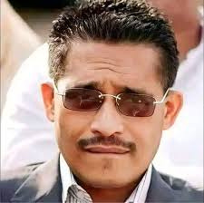
WE ARE
LOOKING FOR
প্রশ্নয...............
ANY QUESTIONS??
PLEASE DON’T ASK ANY :)

Slide 19

THANK YOU
FOR WATCHING

Slide 20

This slide was presented to:
Md. Asif Khan Rifat
Lecturer
Department of CSE
East West University

